Slide 1


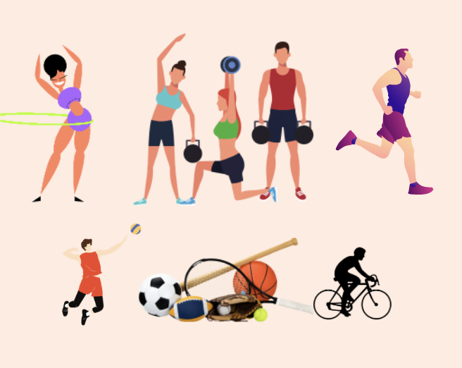
FITNESS FOR FUN
CIS 5040
Spring 2022

Slide 2





Our Team – Fab 5
ANUSHA
PHUE
LOHITHA
PRATIKSHA
LANNY

Slide 3

Overall Approach
Project Goal
Problem Solving Process
Solutions
Prototype and Product Development
Implementation Plan

Slide 4
Overall Approach
Project Goal
Overall, the approach starts with the project aim to guide the rest of the process
Problem Solving Process
To achieve the project goal, we used resources to mitigate the issues described in the next slides
Prospective Solutions
Selected Solution
Prototype Development
Figma
Canva
App
Our solutions needed to inculcate fitness as part of students' routine and make it fun
Our final solution has all resources in one place for easy access

Slide 5

Are you ready to fuel your fitness journey?
What makes fitness a routine?
No Time for fitness?
No idea what to do?
Want to have fun by yourself or with friends?
Do you need motivation?

Slide 6


Project Goal
GOAL: How do we engage CSULA students in physical activities so that they have a healthy lifestyle?

Slide 7

Problem Solving Process
Issues Identified
Awareness issues
Transportation issues
Motivation issues
Time Issues

Slide 8
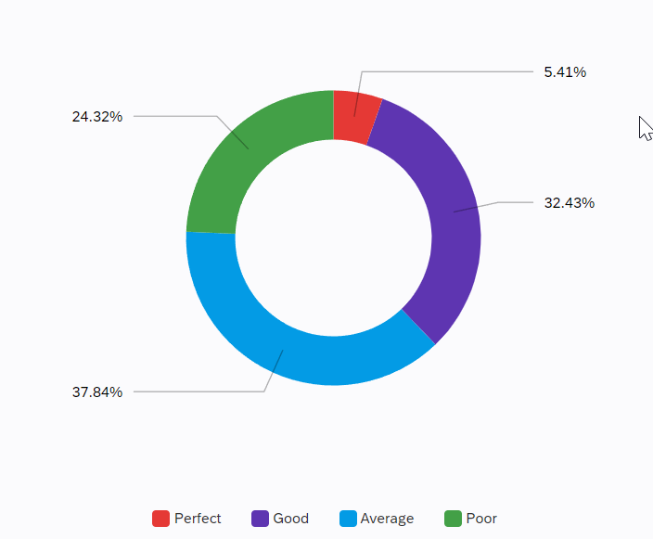
What is your current level of fitness?

Slide 9
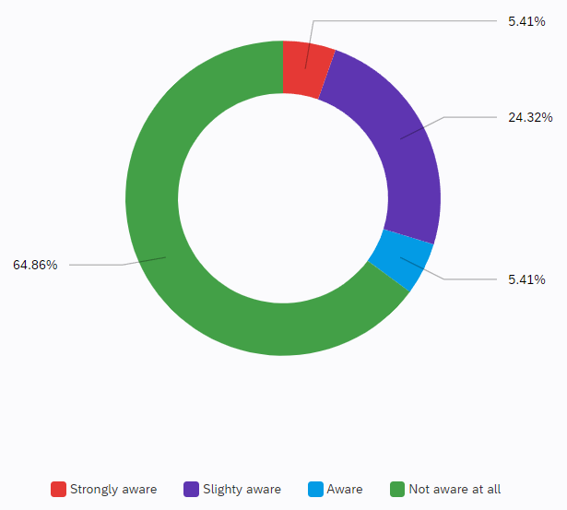
Awareness Issue
How well are you aware of the fitness activities hosted by CSULA students?

Slide 10
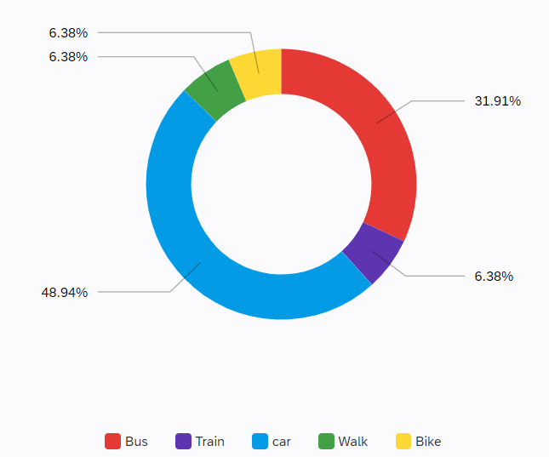
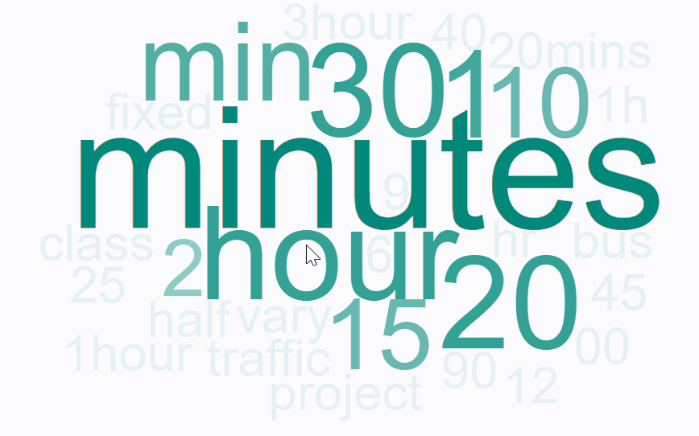
Transportation Issues
What is your commute time?
How do you commute to campus?

Slide 11
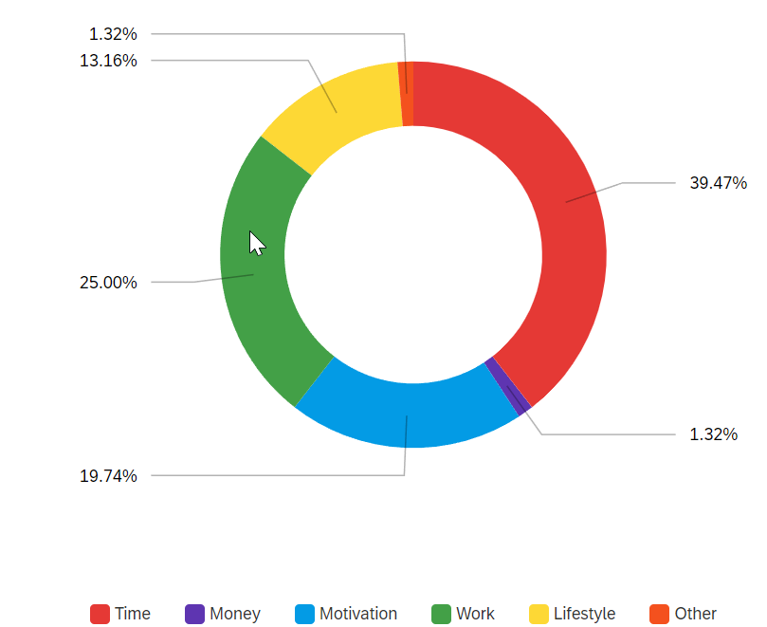
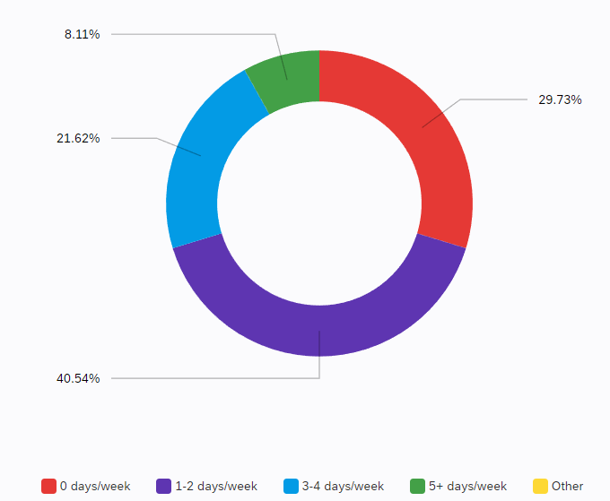
Motivation/Time Issues
What is stopping you from working out more often?
How often do you workout/play sports?

Slide 12

Problem Solving Process (cont.)
Resources Used
CSULA students
Campus resources
Online video platforms
Online fitness resources
Focus group study
Survey results

Slide 13
Solutions
App
Website
Dashboard of events
Notes:
We ended up picking the app!
Our original plan was to bring awareness to CSULA fitness activities.
Based on survey results and our focus group discussion, we changed our plan to bring motivation to all students, regardless of where they participate.
In our focus group discussion, everyone was saying how they wouldn't want to participate in activities offered online and how not everyone is available at the times offered.

Slide 14
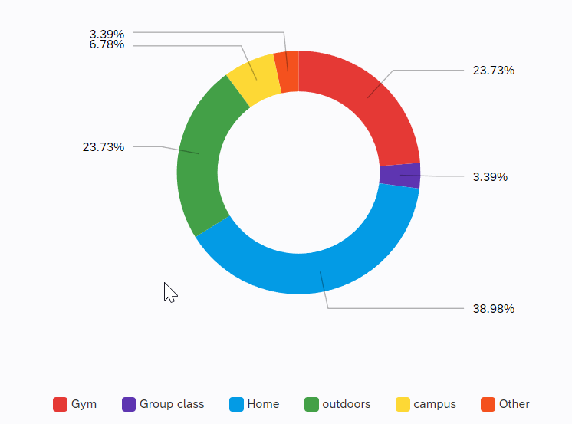
Where do you workout/play sports?

Slide 15
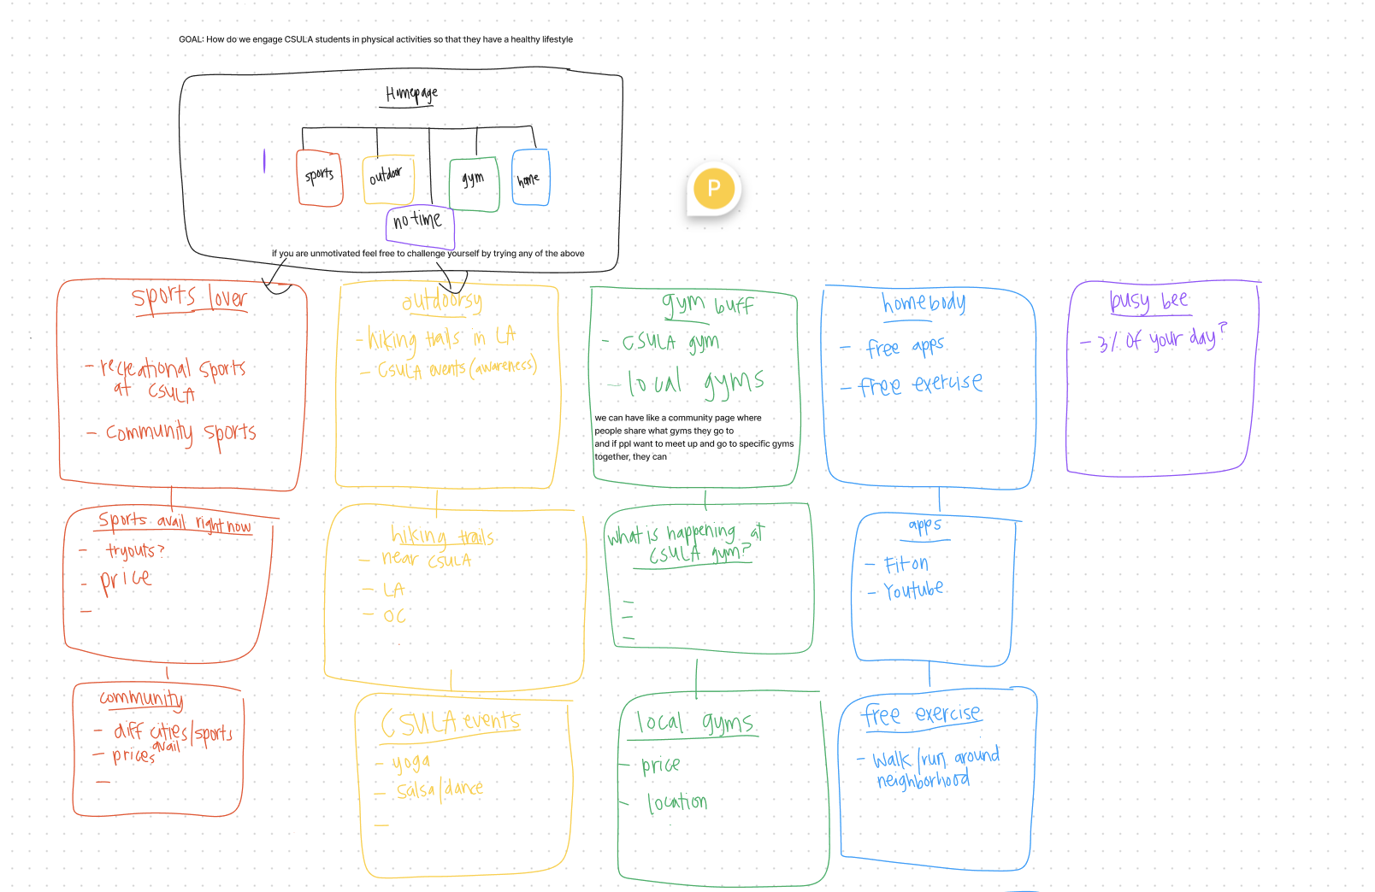
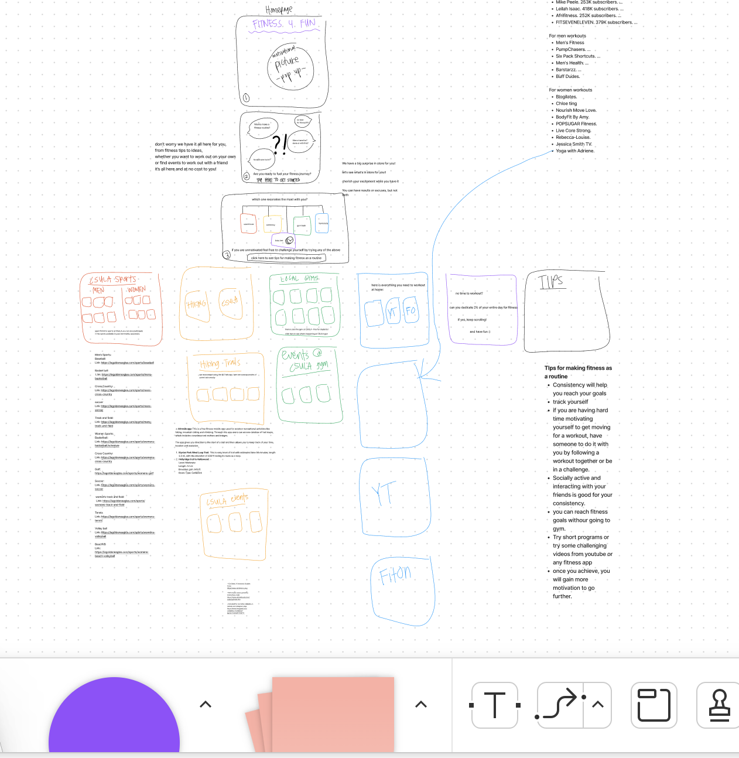
Prototype Development
Figma sketch
https://www.figma.com/file/pClNUaxG8qR56ZqWDea9zE/Untitled?node-id=9%3A795

Slide 16
Prototype Development (cont.)
Canva
https://www.canva.com/design/DAE-Wnk8_zo/NmtKyhXK7ZcIYLT-wmOcMQ/view?utm_content=DAE-Wnk8_zo&utm_campaign=designshare&utm_medium=link&utm_source=homepage_design_menu
^ that is a view-only link
Can you dedicate 2% of your entire day for fitness?

Slide 17
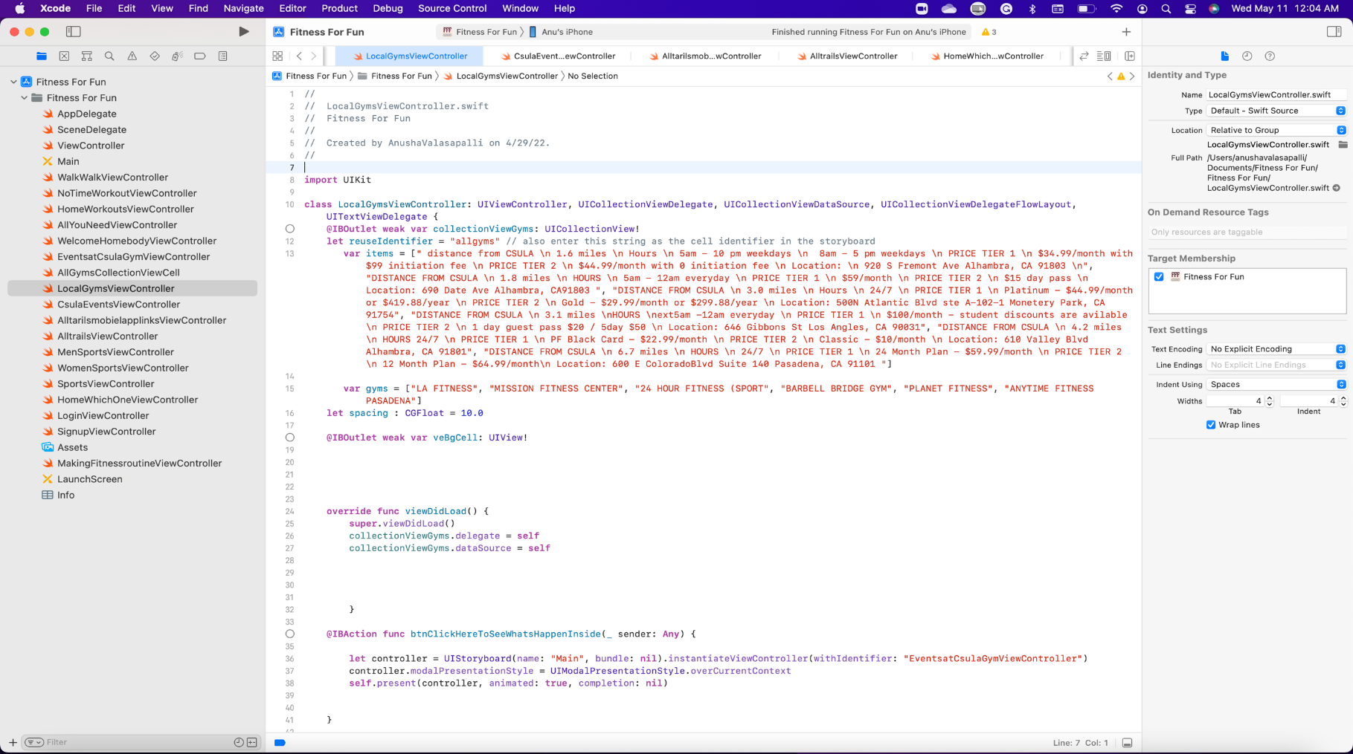
Product Development (cont.)
App Support: iPhone
IDE: XCode
Code: Swift
UI Design: Story Board
Debugger: Simulator, iPhone
Developer account price: 99$
Appstore link: coming soon

Slide 18

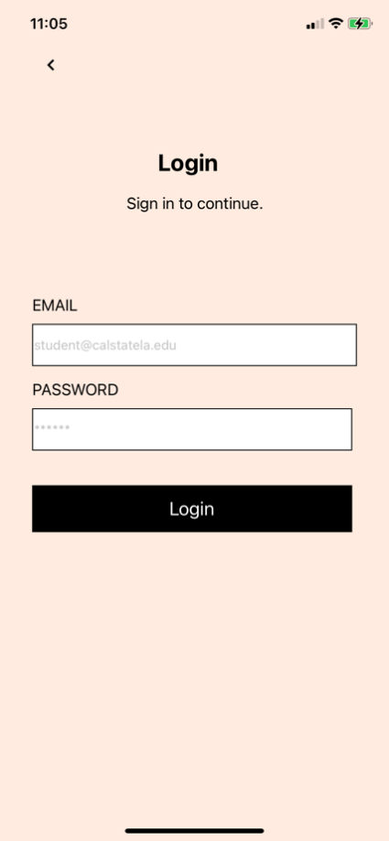
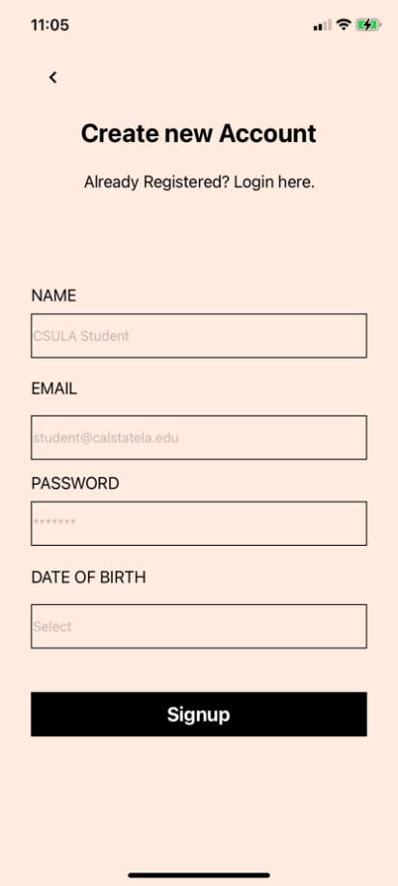
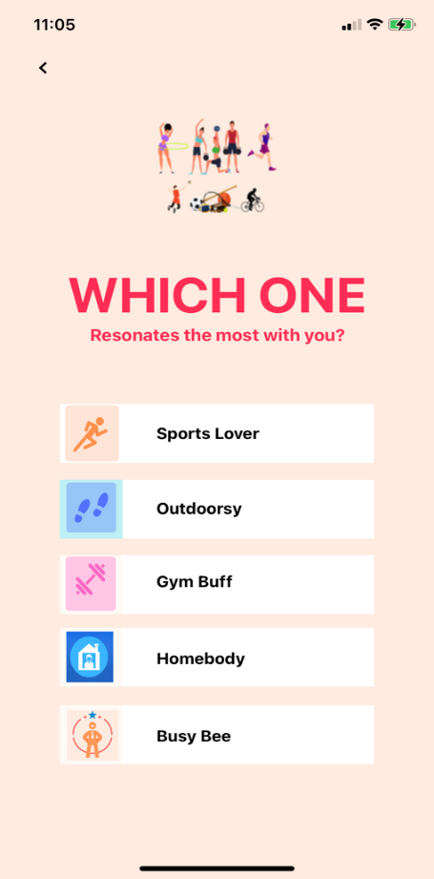
Product Development (cont.)
Finished app

Slide 19

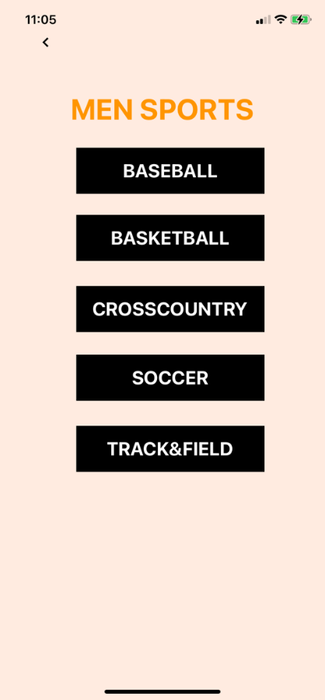
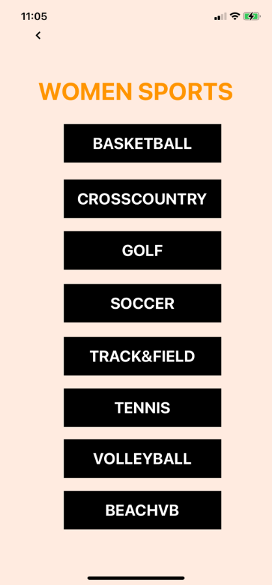
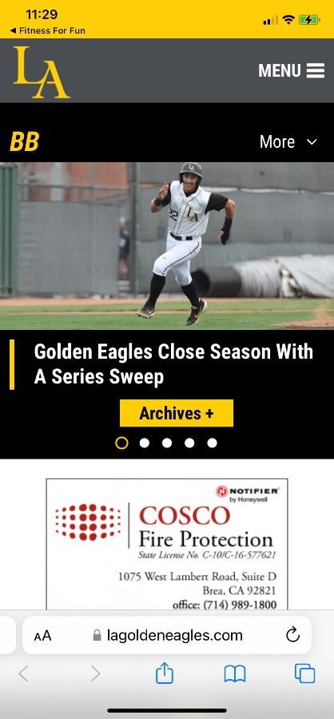
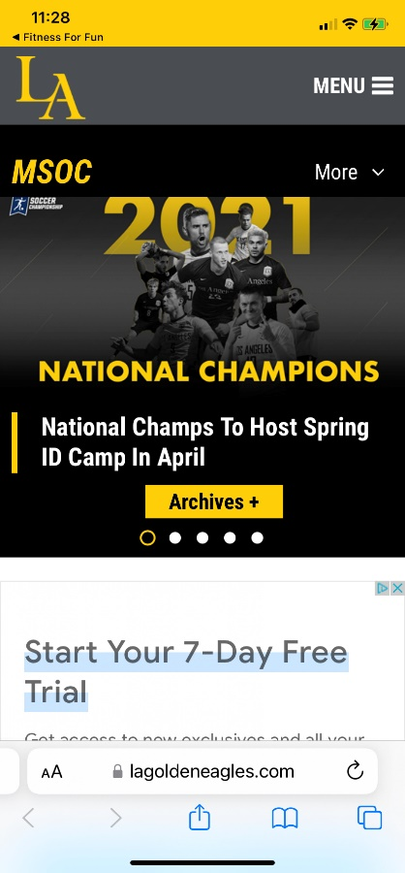
Product Development (cont.)
Sports Lover Flow

Slide 20
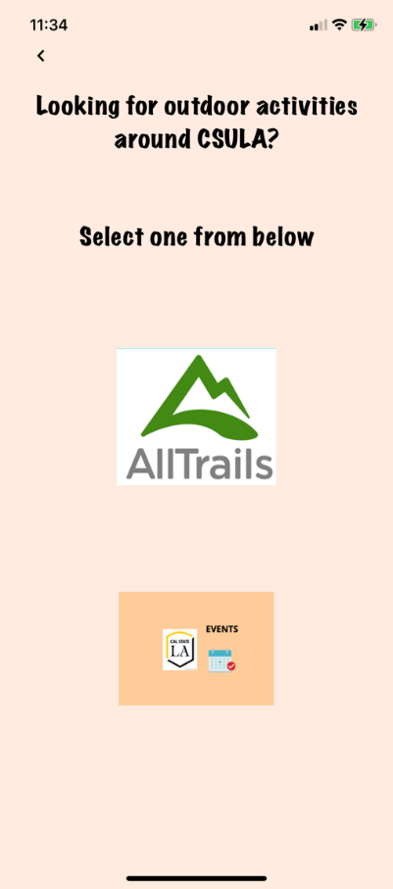
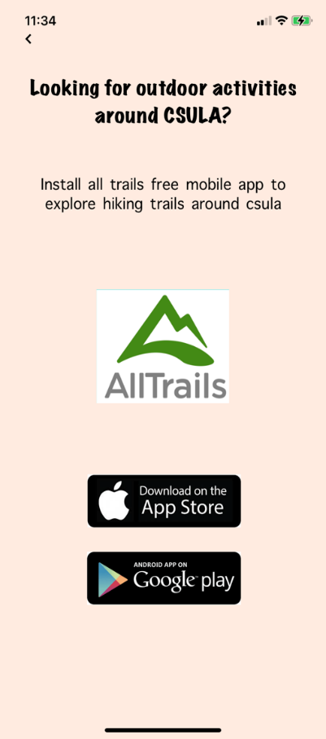
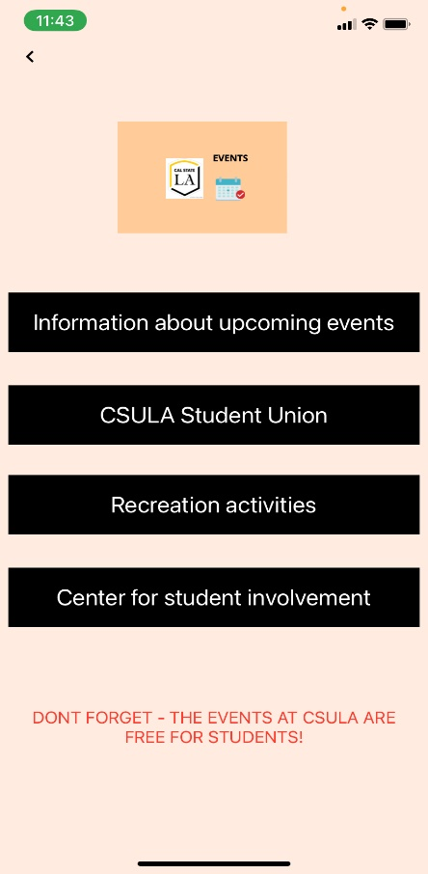
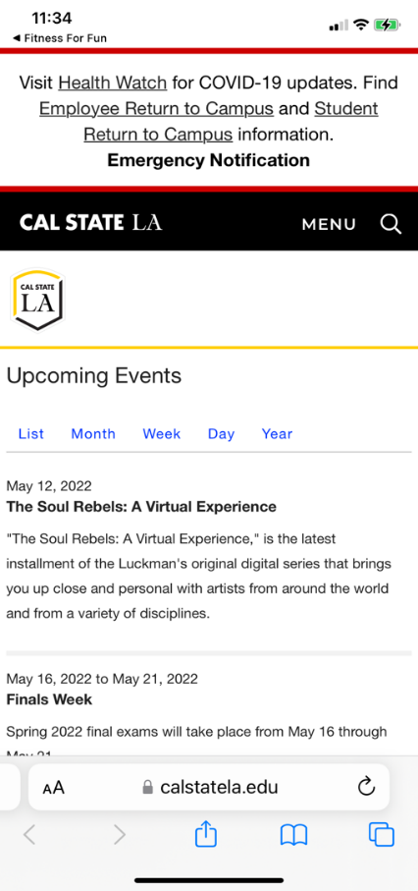
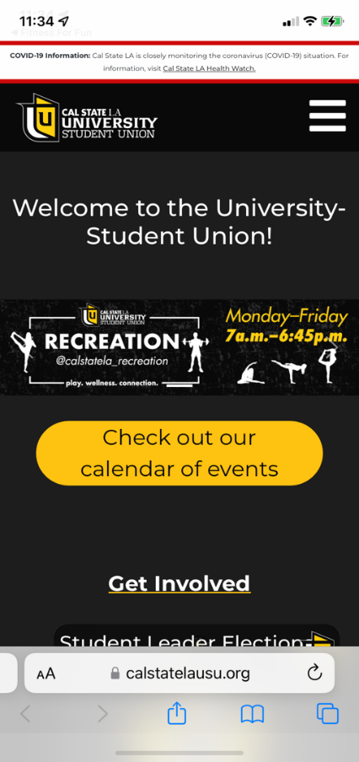
Product Development (cont.)
Outdoorsy Flow

Slide 21
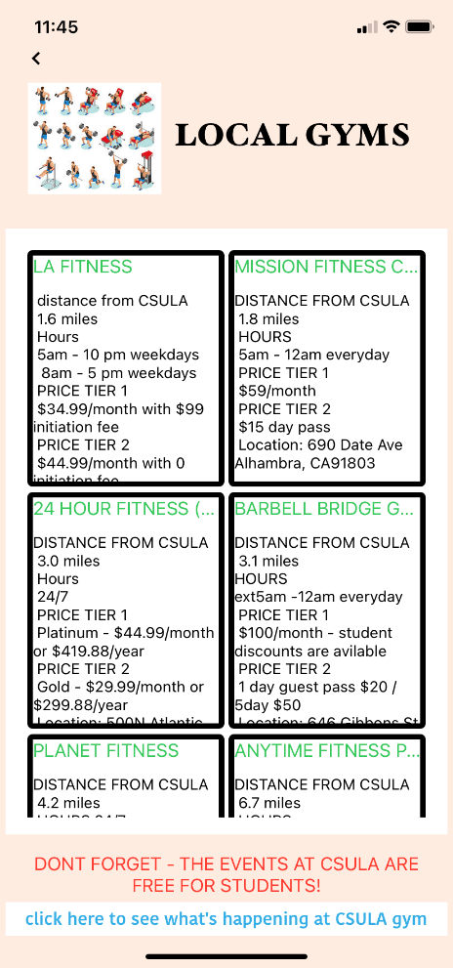
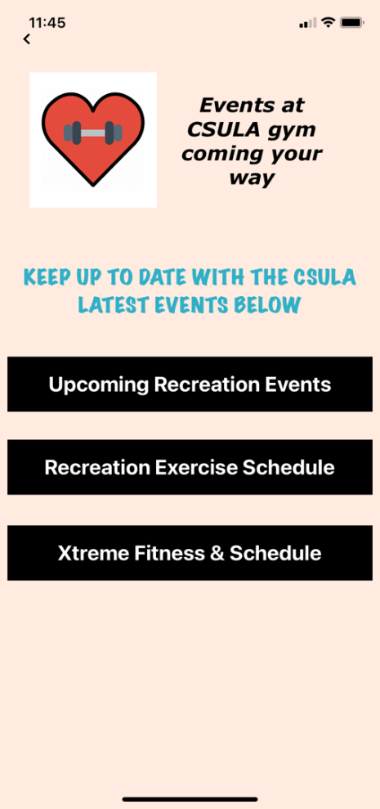
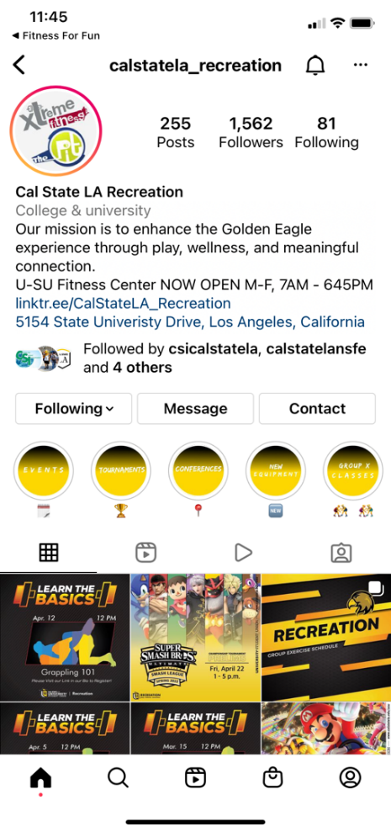
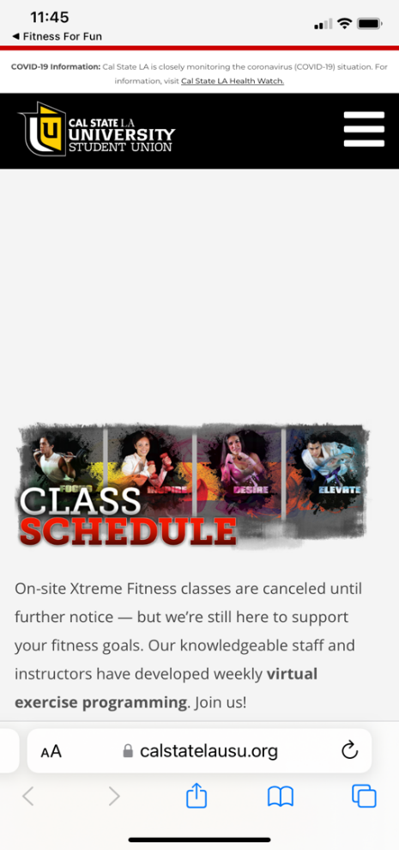
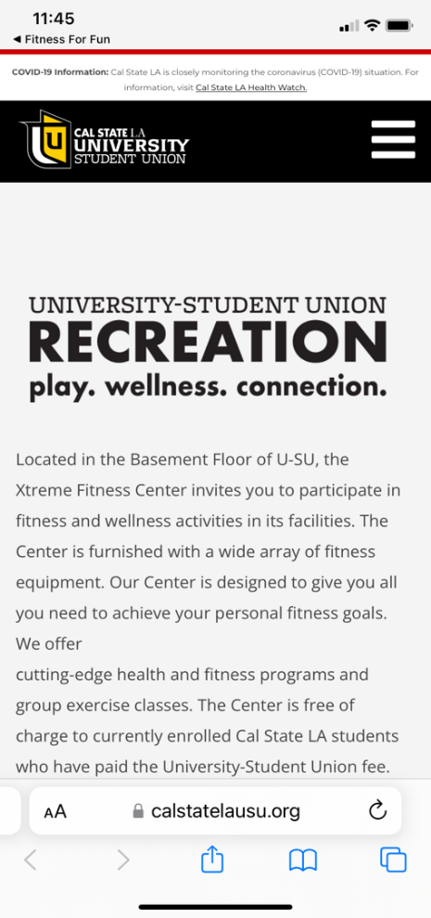
Product Development (cont.)
Gym Buff Flow

Slide 22
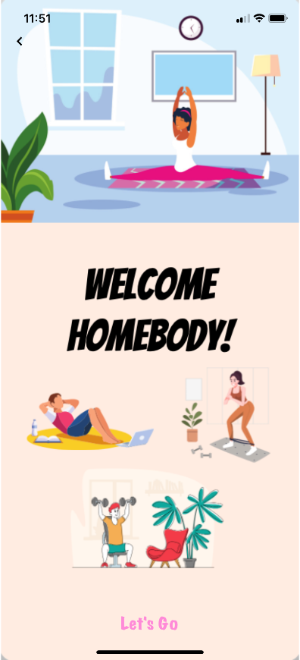
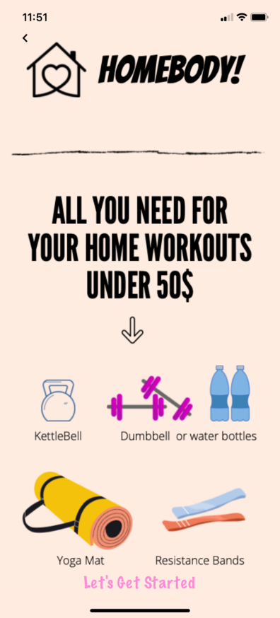
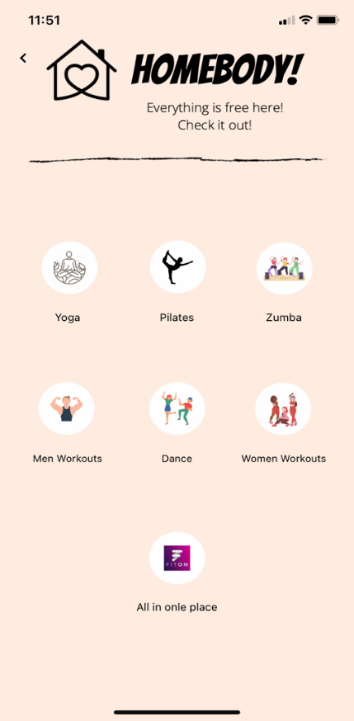
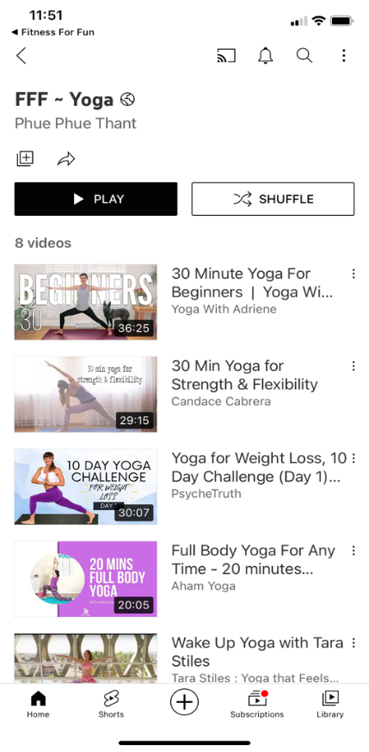
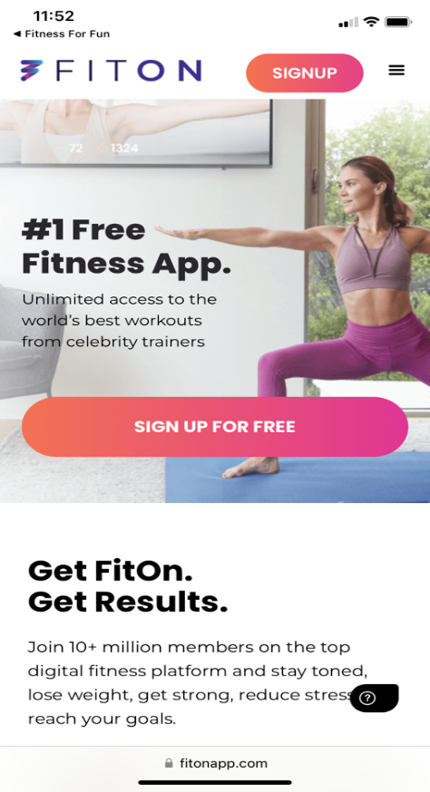
Product Development (cont.)
Home Body Flow

Slide 23
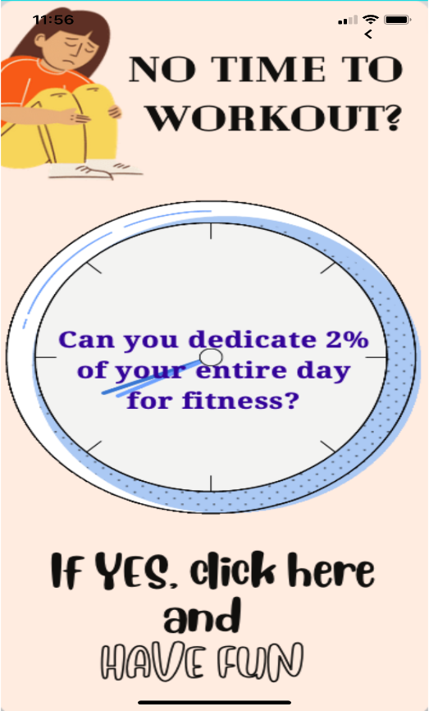

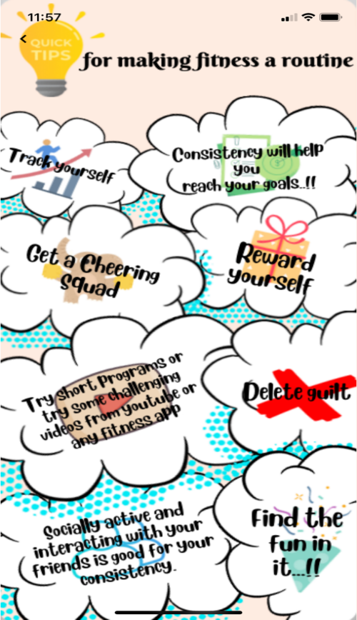
Product Development (cont.)
Busy Bee Flow

Slide 24
Implementation Plan
Connect with CSULA Student Union and Recreational Center
Promote the application in Orientation of different Departments at the beginning of every semester

Slide 25

Quick Tips To Make Fitness a Routine
Keep track and keep yourself accountable
Get a cheering squad
Reward yourself
Consistency will help you reach your goals
Delete guilt
Find the fun in it
Try short programs or some challenging videos from YouTube or a fitness app
Staying socially active and interacting with your friends can help maintain consistency

Slide 26

A little progress each day adds up to BIG results!

Slide 27

Thank You

